Slide 1

19CS2211 - Software Engineering
Software Testing – Black-box Testing
Session – 21

Slide 2

Black-box Testing
It is called as behavioral testing
Focuses - functional requirements of software.
Enable sets of input conditions - fully exercise all functional requirements for a program.
Black-box testing is not an alternative to white-box techniques.
To uncover a different class of errors.

Slide 3
Tests are designed to answer the following questions:
How is functional validity tested?
How are system behavior and performance tested?
What classes of input will make good test cases?
Is the system particularly sensitive to certain input values?
How are the boundaries of a data class isolated?
What data rates and data volume can the system tolerate?
What effect will specific combinations of data have on system operation?

Slide 4
By applying black-box techniques, you derive a set of test cases that satisfy the following criteria:
test cases that reduce, by a count that is greater than one, the number of additional test cases that must be designed to achieve reasonable testing, and
test cases that tell you something about the presence or absence of classes of errors, rather than an error associated only with the specific test at hand.

Slide 5
Graph-Based Testing Methods
Understand the objects in software
Connect these objects using relationships.
Define a series of tests - all objects have the expected relationship to one another.
A number of behavioral testing methods that can make use of graphs:
Transaction flow modeling.
Finite state modeling.
Data flow modeling.
Timing modeling.

Slide 6
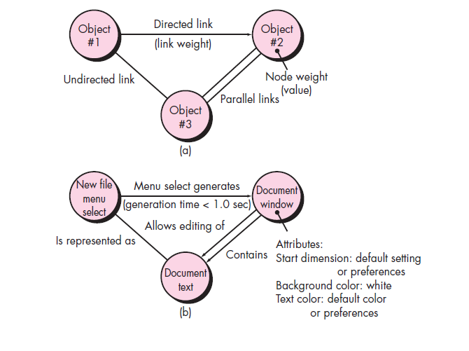
(a) Graph notation (b) simple example

Slide 7
Equivalence Partitioning
It is a black-box testing method.
Divides the input domain into classes of data
from these data - test cases can be derived.
Test-case design - based on an evaluation of equivalence classes for an input condition.

Slide 8
Equivalence classes may be defined according to the following guidelines:
1. If an input condition specifies a range, one valid and two invalid equivalence classes are defined.
2. If an input condition requires a specific value, one valid and two invalid equivalence classes are defined.
3. If an input condition specifies a member of a set, one valid and one invalid equivalence class are defined.
4. If an input condition is Boolean, one valid and one invalid class are defined.

Slide 9
Boundary Value Analysis (BVA)
More errors occurs at the boundaries in input
Lesser errors in “center” in input
For this reason that boundary value analysis (BVA) has been developed as a testing technique.
BVA leads to a selection of test cases that exercise bounding values.

Slide 10
Guidelines for BVA are similar in many respects to those provided for equivalence partitioning:
If an input condition specifies a range bounded by values a and b, test cases should be designed with values a and b and just above and just below a and b.
If an input condition specifies a number of values, test cases should be developed that exercise the minimum and maximum numbers. Values just above and below minimum and maximum are also tested.

Slide 11
Apply guidelines 1 and 2 to output conditions. Test cases should be designed to create an output report that produces the maximum (and minimum) allowable number of table entries.
If internal program data structures have prescribed boundaries (e.g., a table has a defined limit of 100 entries), be certain to design a test case to exercise the data structure at its boundary.

Slide 12
Orthogonal Array Testing
Applied to problems in which the input domain is relatively small but too large to accommodate exhaustive testing.
Useful in finding region faults - faulty logic within a software component.

Slide 13
Black-box Testing
To find errors in the following categories:
incorrect or missing functions
interface errors
errors in data structures or external database access
behavior or performance errors
initialization and termination errors

Slide 14
Thank You

